Slide 1









Data structure and algorithm
CSE 2218
Md Musfiqur Rahman – 011 221 334
Md Azizul Haque Noman – 011 221 338

Slide 2
Edmond’s Karp
Algorithm
3/3
A
B
4/5
4/7
S
2/2
3/3
1/3
t
3/3
3/4
C
D
1/1

Slide 3





Edmonds-Karp algorithm
What is the Edmond’s Karp Algorithm & Why??

Slide 4
Edmonds-Karp algorithm
Definition
Edmonds–Karp algorithm is an implementation of the Ford–Fulkerson method for computing the maximum flow in a flow network.

Slide 5
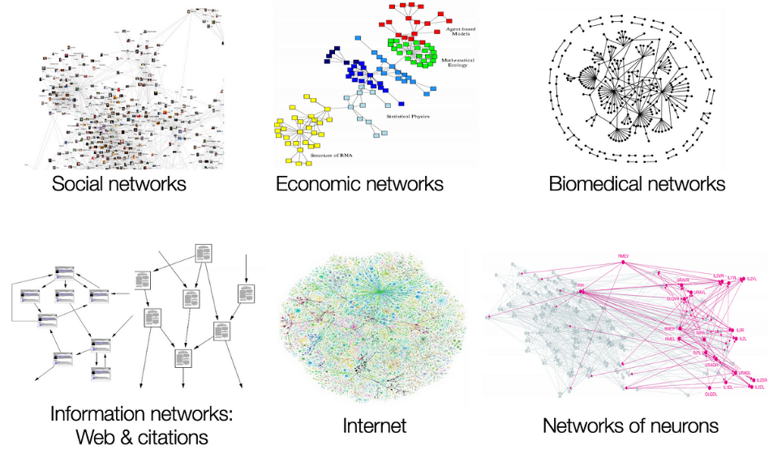
Edmonds-Karp algorithm
History
To solve the maximum flow problem, Ford-Fulkerson algorithm proposed by L.R. Ford, Jr. and D.R. Fulkerson in 1956
Edmond’s Karp algorithm first published by Yefim Dinitz in 1970 and independently published by Jack Edmonds and Richard Karp in 1972.

Slide 6
Edmonds-Karp algorithm-Terminologies
Graph Theory
BFS
Queue
Augmenting Path

Slide 7
Edmonds-Karp algorithm-ALGORITHM
Step’s of Algorithm
Initialize the flow network
Calculate the residual graph
Find an augmenting path
Calculate the bottleneck capacity
Update the flow
Repeat steps 2-5
Terminate the algorithm

Slide 8
Edmonds-Karp algorithm-Pseudocode
22. Function MaxFlow(s, t):
23. Initialize flow as 0
24. Create a parent array of size n
25. Initialize new_flow
26. while new_flow = BFS(s, t, parent):
27. Increment flow by new_flow
28. Set cur = t
29. while cur is not equal to s:
30. Set prev = parent[cur]
31. Reduce capacity[prev][cur] by new_flow
32. Increase capacity[cur][prev] by new_flow
33. Set cur = prev
34. Return flow
1. Initialize:
2. n as the number of nodes
3. capacity as a 2D array representing edge capacities
4. adj as a 2D array representing the adjacency list
5. Function BFS(s, t, parent):
6. Create a queue q
7. Set all elements of parent array to -1
8. Set parent[s] = -2
9. Enqueue {s, INF} into q
10. while q is not empty:
11. cur = q.front().first
12. flow = q.front().second
13. Dequeue q
14. for each next node in adj[cur]:
15. if parent[next] == -1 and capacity[cur][next] > 0:
16. Set parent[next] = cur
17. new_flow = min(flow, capacity[cur][next])
18. if next == t:
19. Return new_flow
20. Enqueue {next, new_flow} into q
21. Return 0

Slide 9
Edmonds-Karp algorithm-SIMULATION
0/3
A
B
0/7
Flow = 0
0/5
S
0/2
0/3
0/3
t
0/3
0/4
C
D
0/1

Slide 10
Edmonds-Karp algorithm-SIMULATION
3/3
Flow = 3
A
B
3/5
3/7
S
0/2
0/3
0/3
t
S
A
B
t
0/3
0/4
C
D
0/1

Slide 11
Edmonds-Karp algorithm-SIMULATION
3/3
Flow = 3
A
B
3/7
3/5
S
0/2
0/3
0/3
t
0/3
0/4
C
D
0/1

Slide 12
Edmonds-Karp algorithm-SIMULATION
3/3
Flow = 5
A
B
3/5
3/7
S
2/2
2/3
0/3
t
S
C
A
D
t
2/3
2/4
C
D
0/1

Slide 13
Edmonds-Karp algorithm-SIMULATION
3/3
Flow = 5
A
B
3/7
3/5
S
2/2
2/3
0/3
t
2/3
2/4
C
D
0/1

Slide 14
Edmonds-Karp algorithm-SIMULATION
3/3
Flow = 6
A
B
4/5
4/7
S
2/2
3/3
1/3
t
S
A
D
B
t
2/3
2/4
C
D
0/1

Slide 15
Edmonds-Karp algorithm-SIMULATION
3/3
Flow = 6
A
B
4/5
4/7
S
2/2
3/3
1/3
t
2/3
2/4
C
D
0/1

Slide 16
Edmonds-Karp algorithm-SIMULATION
3/3
Flow = 7
A
B
4/5
4/7
S
2/2
3/3
1/3
t
S
C
D
t
3/3
3/4
C
D
1/1

Slide 17
Edmonds-Karp algorithm-SIMULATION
3/3
Flow = 7
A
B
4/5
4/7
S
2/2
3/3
1/3
t
3/3
3/4
C
D
1/1

Slide 18



Special case
Multiple Source/Sink
Node capacity (if have)

Slide 19
Multiple source/sink
0/7
0/5
A
B
0/3
t1
∞
∞
S1
0/2
0/3
0/3
Super Sink
Super Source
∞
S2
t1
∞
0/4
0/3
C
D
0/1

Slide 20
node capacity
7
0/3
A
B
0/7
0/5
S
0/2
0/3
0/3
t
0/3
0/4
C
D
0/1

Slide 21
node capacity
7
0/3
A1
A2
B
0/7
0/5
0/2
0/3
0/3
t
S
0/3
0/4
C
D
0/1

Slide 22


Application
Transportation Networks
Telecommunications
Computer Networks

Slide 23







QnA

Slide 24

Thank you!
.

